Slide 1
BUS 443: Business Analytics
Chapter 1
Introduction to Business Analytics
(History of BI Video)

Slide 2
Three Developments Causing Business Analytics Growth
Technological advances, Internet social networks, and data generated from personal electronic devices produce incredible amounts of data for businesses.
Ongoing research has resulted in numerous methodological developments, including advances in computational approaches to effectively handle and explore massive amounts of data, faster algorithms for optimization and simulation, and more effective approaches for visualizing data.
The methodological developments were paired with an explosion in computing power and storage capability. Better computing hardware, parallel computing, and cloud computing have enabled businesses to solve big problems faster and more accurately than ever before.
Notes:
Businesses want to use these data to improve the efficiency and profitability of their operations, better understand their customers, price their products more effectively, and gain a competitive advantage.
Technological advances such as improved point-of-sale scanner technology and the collection of data through e-commerce have added to the big data issue.
Cloud computing, the more recent development, is the remote use of hardware and software over the Internet.

Slide 3
Big Data
Big data: A set of data that cannot be managed, processed, or analyzed with commonly available software in a reasonable amount of time.
Big data represents opportunities.
It also presents analytical challenges from a processing point of view and consequently has itself led to an increase in the use of analytics.
More companies are hiring data scientists who know how to process and analyze massive amounts of data.
Walmart handles over one million purchase transactions per hour. Facebook processes more than 250 million picture uploads per day.

Slide 4








The 6V’s of Big Data
VOLUME
VELOCITY
SCALE OF DATA
ANALYSIS OF STREAMING DATA
VARIETY
VALIDITY
DIFFERENT FORMS OF DATA
ACCURACY OF DATA
2015
4.4 MILLION IT JOBS
Will be created to support
Big Data
VERACITY
VOLATILITY
UNCERTAINTY OF DATA
LIFESPAN OF DATA
Notes:
From 1986 to 2007, we saw transformative and massive growth in data volume, variety and computing capacity. It is Laney who first defined Big Data by its volume, variety and velocity. Since 2011-2012, researchers also noted that 3 more categories could be added to the Laney’s definition: Veracity, Validity and Volatility.
Source: Work of a former PCOM student, Perrine Lacroix.
VOLUME: One factor that could explain the abundance of data is the fact that 6 Billion people have a cell phone. The world population is around 7 Billion.
The abundance of data and data variety combined with new advanced analytics techniques and increased computing power leads to tremendous opportunities for business.

Slide 5
The Goal: Better Decision Making
Strategic decisions: Involve higher-level issues concerned with the overall direction of the organization. These decisions define the organization’s overall goals and aspirations for the future.
Tactical decisions: Concern how the organization should achieve the goals and objectives set by its strategy. They are usually the responsibility of midlevel management.
Operational decisions: Affect how the firm is run from day to day. They are the domain of operations managers, who are the closest to the customer.
Notes:
Managers’ responsibility:
To make strategic, tactical, or operational decisions.

Slide 6
Common Approaches to Decision Making
Tradition
Intuition
Rules of thumb
Using the relevant data available
Firms guided by data-driven decision making have higher productivity and market value and increased output and profitability. This was confirmed by a recent study on a large sample of firms.

Slide 7
Business Analytics Defined
Business analytics is the scientific process of transforming data into insight for making better decisions. Used for data-driven or fact-based decision making, which is often seen as more objective than other alternatives for decision making.
Tools of business analytics can aid decision making by creating insights from data, improving our ability to more accurately forecast for planning, helping us quantify risk, and yielding better alternatives through analysis and optimization

Slide 8
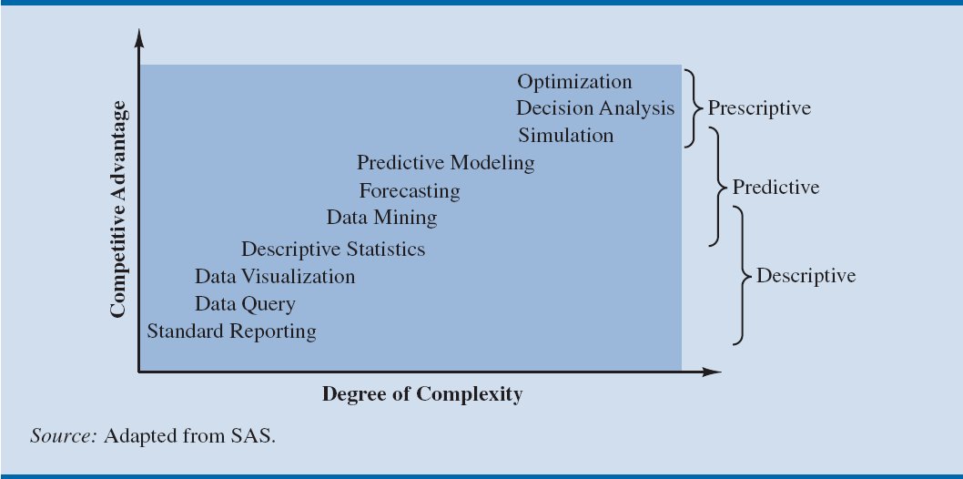
The Spectrum of Business Analytics
Notes:
Companies that apply analytics often follow a trajectory similar to that shown in Figure 1.2. Organizations start with basic analytics in the lower left. As they realize the advantages of these analytic techniques, they often progress to more sophisticated techniques in an effort to reap the derived competitive advantage. Predictive and prescriptive analytics are sometimes therefore referred to as advanced analytics.

Slide 9
A Categorization of Analytical Methods and Models
Descriptive analytics: It encompasses the set of techniques that describes what has happened in the past. Examples include data queries, reports, descriptive statistics, data visualization (data dashboards), data-mining techniques, and basic what-if spreadsheet models.
Data query - It is a request for information with certain characteristics from a database.
Data dashboards - Collections of tables, charts, maps, and summary statistics that are updated as new data become available.
Notes:
Uses of dashboards
To help management monitor specific aspects of the company’s performance related to their decision-making responsibilities.
For corporate-level managers, daily data dashboards might summarize sales by region, current inventory levels, and other company-wide metrics.
Front-line managers may view dashboards that contain metrics related to staffing levels, local inventory levels, and short-term sales forecasts.

Slide 10
Techniques used in Predictive Analytics
Predictive analytics: It consists of techniques that use models constructed from past data to predict the probability of the future or ascertain the impact of one variable on another. Survey data and past purchase behavior may be used to help predict the market share of a new product.
Data mining
Used to find patterns or relationships among elements of the data in a large database; often used in predictive analytics.
It involves the use of probability and statistics to construct a computer model to study the impact of uncertainty on a decision.
Simulation
Notes:
Example for Data Mining:
A large grocery store chain might be interested in developing a new targeted marketing campaign that offers a discount coupon on potato chips.
By studying historical point-of-sale data, the store may be able to use data mining to predict which customers are the most likely to respond to an offer on discounted chips by purchasing higher-margin items such as beer or soft drinks in addition to the chips, thus increasing the store’s overall revenue.
Example for Simulation:
Banks often use simulation to model investment and default risk in order to stress test financial models.
Used in the pharmaceutical industry to assess the risk of introducing a new drug.

Slide 11
A Categorization of Analytical Methods and Models
Prescriptive Analytics: It indicates a best course of action to take
Models used in prescriptive analytics:
Optimization models
Simulation optimization
Decision analysis
Models that give the best decision subject to constraints of the situation.
Combines the use of probability and statistics to model uncertainty with optimization techniques to find good decisions in highly complex and highly uncertain settings.
Used to develop an optimal strategy when a decision maker is faced with several decision alternatives and an uncertain set of future events.
It also employs utility theory, which assigns values to outcomes based on the decision maker’s attitude toward risk, loss, and other factors.

Slide 12
Business Analytics in Financial Analytics
Use of predictive models
To forecast future financial performance
To assess the risk of investment portfolios and projects
To construct financial instruments such as derivatives
Use of prescriptive models
To construct optimal portfolios of investments
To allocate assets, and to create optimal capital budgeting plans.
Simulation is also often used to assess risk in the financial sector
Notes:
Portfolio models in finance use historical investment return data to determine the mix of investments that yield the highest expected return while controlling or limiting exposure to risk.
Example for use of prescriptive models: GE Asset Management uses optimization models to decide how to invest its own cash received from insurance policies and other financial products, as well as the cash of its clients such as Genworth Financial. The estimated benefit from the optimization models was $75 million over a five-year period.
Example for use of simulation: Deployment by Hypo Real Estate International of simulation models to successfully manage commercial real estate risk.

Slide 13
Business Analytics in Practice Marketing Analytics
Marketing is one of the fastest growing areas for the application of analytics. A better understanding of consumer behavior through the use of scanner data and data generated from social media has led to an increased interest in marketing analytics.
Understanding of consumer behavior through marketing analytics leads to:
The better use of advertising budgets
More effective pricing strategies
Improved forecasting of demand
Improved product line management, and
Increased customer satisfaction and loyalty
Notes:
Price markdown models in retailing use historical data to yield revenue-maximizing discount levels and the timing of discount offers when goods have not sold as planned.
Example of high-impact marketing analytics:
Automobile manufacturer Chrysler teamed with J. D. Power and Associates to develop an innovate set of predictive models to support its pricing decisions for automobiles.
These models help Chrysler to better understand the ramifications of proposed pricing structures (a combination of manufacturer’s suggested retail price, interest rate offers, and rebates) and, as a result, to improve its pricing decisions.
The models have generated an estimated annual savings of $500 million.

Slide 14
Business Analytics in Practice
Health care analytics
Descriptive, predictive, and prescriptive analytics are used:
To improve patient, staff, and facility scheduling
Patient flow
Purchasing
Inventory control
Use of prescriptive analytics for diagnosis and treatment
Human resource (HR) analytics
New area of application for analytics
The HR function is charged with ensuring that the organization
Has the mix of skill sets necessary to meet its needs
Is hiring the highest-quality talent and providing an environment that retains it, and
Achieves its organizational diversity goals.
Notes:
Example for use of prescriptive analytics for diagnosis and treatment:
Working with the Georgia Institute of Technology, Memorial Sloan-Kettering Cancer Center developed a real-time prescriptive model to determine the optimal placement of radioactive seeds for the treatment of prostate cancer.
Using the new model, 20–30 percent fewer seeds are needed, resulting in a faster and less invasive procedure.
Example for Human Resource (HR) Analytics:
Sears Holding Corporation (SHC), owners of retailers Kmart and Sears, Roebuck and Company, has created an HR analytics team inside its corporate HR function.
The team uses descriptive and predictive analytics to support employee hiring and to track and influence retention.

Slide 15
Business Analytics in Practice
Supply chain analytics
Provide the cost-minimizing plant and distribution center locations subject to meeting the customer service requirements.
The core service of companies such as UPS and FedEx is the efficient delivery of goods, and analytics has long been used to achieve efficiency.
The optimal sorting of goods, vehicle and staff scheduling, and vehicle routing are all key to profitability for logistics companies such as UPS, FedEx, and others like them.
Companies can benefit from better inventory and processing control and more efficient supply chains.
Analytics for government and nonprofits
To drive out inefficiencies
To increase the effectiveness and accountability of programs
Analytics for nonprofit agencies
To ensure their effectiveness and accountability to their donors and clients.
Notes:
Example for supply chain analytics: ConAgra Foods uses predictive and prescriptive analytics to better plan capacity utilization by incorporating the inherent uncertainty in commodities pricing. ConAgra realized a 100 percent return on their investment in analytics in under three months—an unheard of result for a major technology investment.
Example of analytics for government agencies:
The New York State Department has worked with IBM to use prescriptive analytics in the development of a more effective approach to tax collection. The result was an increase in collections from delinquent payers of $83 million over two years.
Example of analytics for nonprofit agencies:
Catholic Relief Services (CRS) is the official international humanitarian agency of the U.S. Catholic community. The CRS mission is to provide relief for the victims of both natural and human-made disasters and to help people in need around the world through its health, educational, and agricultural programs.
CRS uses an analytical spreadsheet model to assist in the allocation of its annual budget based on the impact that its various relief efforts and programs will have in different countries.

Slide 16
Business Analytics in Practice
Sports analytics - Used for player evaluation and on-field strategy in professional sports.
Used to assess players for the amateur drafts and to decide how much to offer players in contract negotiations.
Professional motorcycle racing teams use sophisticated optimization for gearbox design to gain competitive advantage.
Used for off-the-field business decisions. Using prescriptive analytics, franchises across several major sports dynamically adjust ticket prices throughout the season to reflect the relative attractiveness and potential demand for each game.
Web analytics - It is the analysis of online activity, which includes, but is not limited to, visits to Web sites and social media sites such as Facebook and LinkedIn.
Leading companies apply descriptive and advanced analytics to data collected in online experiments to:
Determine the best way to configure Web sites,
Position ads, and
Utilize social networks for the promotion of products and services
Notes:
Online experimentation involves exposing various subgroups to different versions of a Web site and tracking the results. Because of the massive pool of Internet users, experiments can be conducted without risking the disruption of the overall business of the company.
Such experiments are proving to be invaluable because they enable the company to use trial-and-error in determining statistically what makes a difference in their Web site traffic and sales.

Slide 17
Excel Tasks to Review (From Appendix a and chapter 7)
Formulas & Basic Excel Tasks
Graphs (Charts)
Data Tables
Goal Seek
VLOOKUP
SUM/SUMIF/SUMPRODUCT
COUNT/COUNTIF
For next class: Read Chapter 7 and complete problems 2, 4, 10, 12. All of next class will be an Excel lab.

Slide 18
Class exercise today: connor supply company case

